Slide 1
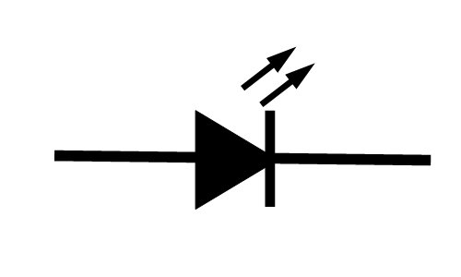
CAN
Transceiver
Cruise Control ECU
CANL
CANH
Occupant Classification ECU
Timer
counter
RAM
LED
PIC
ALU
EEPROM
System Block Diagram

